Slide 1
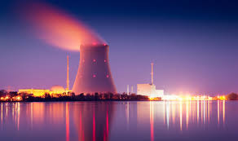
Risk Analysis of a Nuclear Power Plant Project
Arthur Gailes, Eleanya Onuma, Henry Castellanos, Tim Smythe
November 2, 2016

Slide 2
Executive Summary
We conducted an initial risk analysis for a 1,000MW nuclear power plant project, where the investor is a privately-owned utility operating in a competitive wholesale electricity market
Given the extended project timeframe (60+ years), value is expressed in NPV terms, comprising upfront capital costs, annual operating profits, and back-end decommissioning costs
We considered a broad range of revenue and cost uncertainties that influence NPV. Sensitivity analysis identified four (construction cost, construction time, electricity price, capacity factor) as most impactful.
Distributions were fitted to historical data on key uncertainties as a basis for Monte Carlo simulation
The Monte Carlo model yields an expected positive NPV of $298M, but also a significant probability (34%) of a negative NPV outcome, and a VAR0.05 risk measure of -$3.8B NPV
Assuming a Bernoulli utility function with constant risk aversion, the certain equivalent for this risky project is $42M, suggesting a risk premium of $256M
Prior to reaching a project investment decision, we advise investing in more information that could help narrow the range of uncertainty on overnight construction costs, a key driver of downside risk

Slide 3
Nuclear power plants are long-development and long-life infrastructure projects with many inherent risks
Source: Edward Kee. Nuclear Power Plant Business Models. Nera Economic Consulting. 2014.

Slide 4
Upfront capital investment and operating profits depend on a wide range of underlying uncertainties
Construction Delay
Plant Labor
Regulatory Delay
Uranium Price
O&M
Fuel
Materials
Const. Time
Const.Labor
Annual
Operating Cost
Decomm-issioning Cost
Cost of Debt
Overnight Cost
Financing Decision
Total Capital Cost
Cost of Equity
Value (NPV)
Investment Decision
Annual
Revenue
Plant Capacity
Plant Lifespan
Capacity Factor
Electricity Price
Outages
Market Supply
Market Demand
Energy Policy
Economic Conditions
Weather

Slide 5
Through node reduction we can focus on a narrower set, some of which we know in advance or can predict with high confidence
Operating and maintenance costs exhibit low volatility and are consistent across the industry
Depends on the investor’s known cost of capital
O&M
Fuel
Const. Time
Overnight Cost
Annual
Operating Cost
Decomm-issioning Cost
Cost of Debt
Accrued interest during construction
Capital Cost
Financing Decision
Cost of Equity
Discount rate
Value (NPV)
Investment Decision
Annual
Revenue
Plant Capacity
Plant Lifespan
Operator design choice
Assumed = 1,000MW
Capacity Factor
Electricity Price
New nuclear plants are designed for a 60-year life

Slide 6
Among remaining uncertainties, project NPV is most sensitive to construction cost and time, electricity price and capacity factor
Base Case
Construction Overnight Cost
5th Percentile
95th Percentile
Electricity Price
95th Percentile
Selection of uncertainties for Monte Carlo Simulation
5th Percentile
Construction Time
5th Percentile
95th Percentile
Capacity Factor
95th Percentile
5th Percentile
Fuel Costs
5th Percentile
95th Percentile
Decommission Cost
9% of OCC
15% of OCC
Note: The Base Case assumes all variables are at their historical means.

Slide 7
The value function incorporates simulated and deterministic variables
Total Capital Costs =
(including financing costs)
Assumptions
Plant capacity = 1,000MW
Plant life = 60 yrs.
r = .07 (interest rate and discount rate)
Variable O&M = $2.14/MWh
Fixed O&M = $93.3M/yr
Fuel Cost = $6.17/MWh
P = 12%
Where OCC = Overnight Construction Costs in $/kW
n = Construction time in years
Operating NPV =
Where Gen = Annual Generation in MWh = 1,000MW * 8,760hrs/yr * Capacity Factor
Decommissioning NPV =
= Simulated Variable
Where P = Decommissioning costs as a % of overnight capital costs
Assumes decommissioning costs are fully incurred in the year following plant closure (year 61)
NPV = - Capital Costs + NPV Operating Profit – NPV Decommissioning
This formulation of the value function makes certain simplifying assumptions. It is a pre-tax model that ignores the complexities of tax credits and subsidies common in the nuclear energy industry. The model also assumes zero inflation in electricity prices and operating costs over the 60 year operating period.

Slide 8
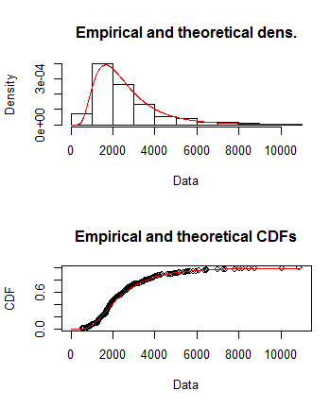
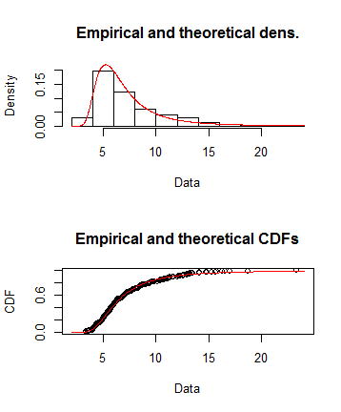
Nearly 50 years of global nuclear construction data were used to fit distributions for overnight costs and construction time
Overnight Construction Costs (OCC)
Construction Time
Log-Gamma Distribution
- Parameters & Fit Statistics -
Inverse Weibull
- Parameters & Fit Statistics -
Log-Gamma Distribution
Inverse Weibull Distribution
Est. SE
Shapelog: 204.9 15.4
Ratelog: 26.5 2.0
Loglikelihood: -3000.2
AIC: 6004.4
BIC: 6012.2
Est. SE
Shape: 3.27 .14
Scale: 5.68 .10
Loglikelihood: -809.2
AIC: 1622.5
BIC: 1630.2
OCC - $/kW
Years
OCC - $/kW
Years
Note: To be consistent with observed historical ranges, the OCC distribution is truncated at $11,000 and the construction time distribution is truncated at 25 years.
Data Source: The Breakthrough Institute, “Historical construction costs of global nuclear power reactors,” 2015.

Slide 9
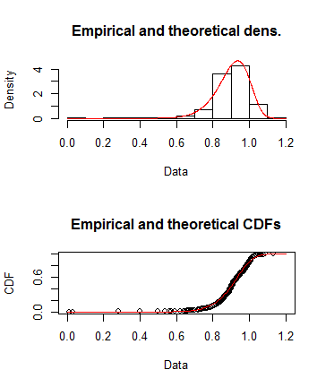
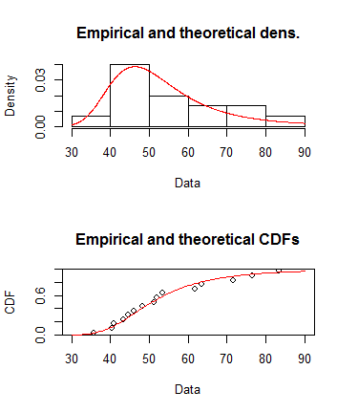
To model revenue, distributions were fitted to historical U.S. data on plant capacity factor and wholesale electricity prices
Capacity Factor
Wholesale Electricity Prices
Weibull Distribution
- Parameters & Fit Statistics -
Inverse-Para-Logistic
- Parameters & Fit Statistics -
Weibull Distribution
Inverse-Para-Logistic Distribution
Est. SE
Shape: 11.9 .34
Scale: .94 .002
Loglikelihood: 752.5
AIC: -1501.0
BIC: -1491.7
Est. SE
Shape: 5.4 1.03
Scale: 35.2 1.96
Loglikelihood: -59.1
AIC: 122.3
BIC: 123.7
Capacity Factor
Electricity prices
Electricity prices
Capacity Factor
Data Sources: Plant-level capacity factors, 2008-2015, from Nuclear Regulatory Commission, Information Digest, Appendix A; Average annual wholesale electricity prices, 2001-2015, PJM West hub from US Energy Information Administration.

Slide 10
The expected NPV is positive, but the distribution is negatively skewed. Alternative formats of the risk curve aid interpretation of upside and downside risk.
NPV Distribution from Monte Carlo Simulation
Mean NPV = $298M
VAR0.05 = ($3.8B)

Slide 11
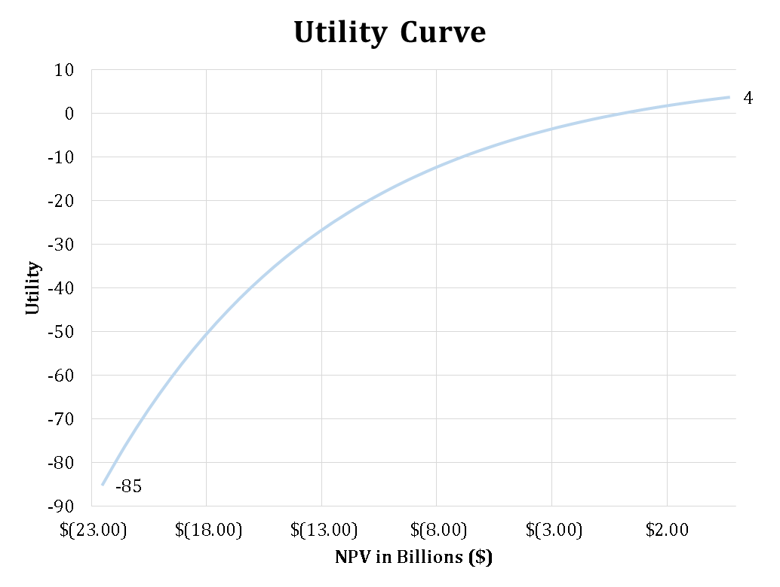
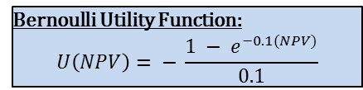
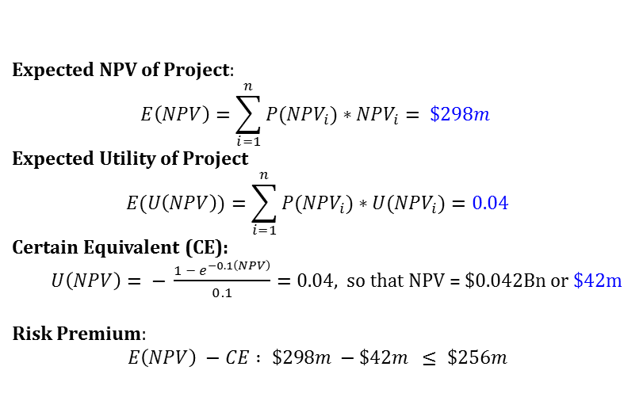
We assume that our firm is risk averse and measure preferences with a Bernoulli Utility Function
Bernoulli Utility Function:
$$U\left(NPV\right)= − \frac{{1 − e}^{−0.1(NPV)}}{0.1}$$
Utility Curve is concave, typical of risk aversion
Expected NPV of Project:
$$E\left(NPV\right)=\sum_{i=1}^{n}{{P(NPV}_{i})∗{NPV}_{i}= \$298m}$$
Expected Utility of Project
$$E(U\left(NPV\right))=\sum_{i=1}^{n}{{P(NPV}_{i})∗{U(NPV}_{i})=0.04}$$
Certain Equivalent (CE):
$U\left(NPV\right)= − \frac{{1 − e}^{−0.1\left(NPV\right)}}{0.1}=0.04$, so that NPV = $0.042Bn or $42m
Risk Premium:
$$E\left(NPV\right) −CE : \$298m −\$42m ≤ \$256m$$
Based on the utility function, our firm will be indifferent between receiving $42m with certainty or $298m in expectation. If the power plant project is pursued, we will be willing to pay <= $256m as an insurance premium.

Slide 12
Areas for further analysis
Given the scale of investment and range of potential outcomes, we recommend investing in additional information
Historical global overnight construction costs (the basis for our simulation distribution) vary widely and account for much of the variation in project NPV. A more detailed planning exercise that specifies the reactor technology and estimates the labor and materials costs for a particular plant design in the local market could substantially decrease the range of uncertainty on capital costs.
Electricity prices and plant capacity factor are a function of competition from other energy sources. The historical data used in our model may not accurately approximate the level of future uncertainty in these variables if the market context shifts significantly (e.g. policy decisions to put a price on carbon emissions or subsidies for renewables).
Evaluation of alternative investment opportunities to inform decision making on whether or not to invest in the nuclear power project

